Slide 1

CIO who has made an effective digital transformation:
Timothy Kasbe
By,
Anderson Klein
Sankalp
Srivatsav Vuddamarry

Slide 2
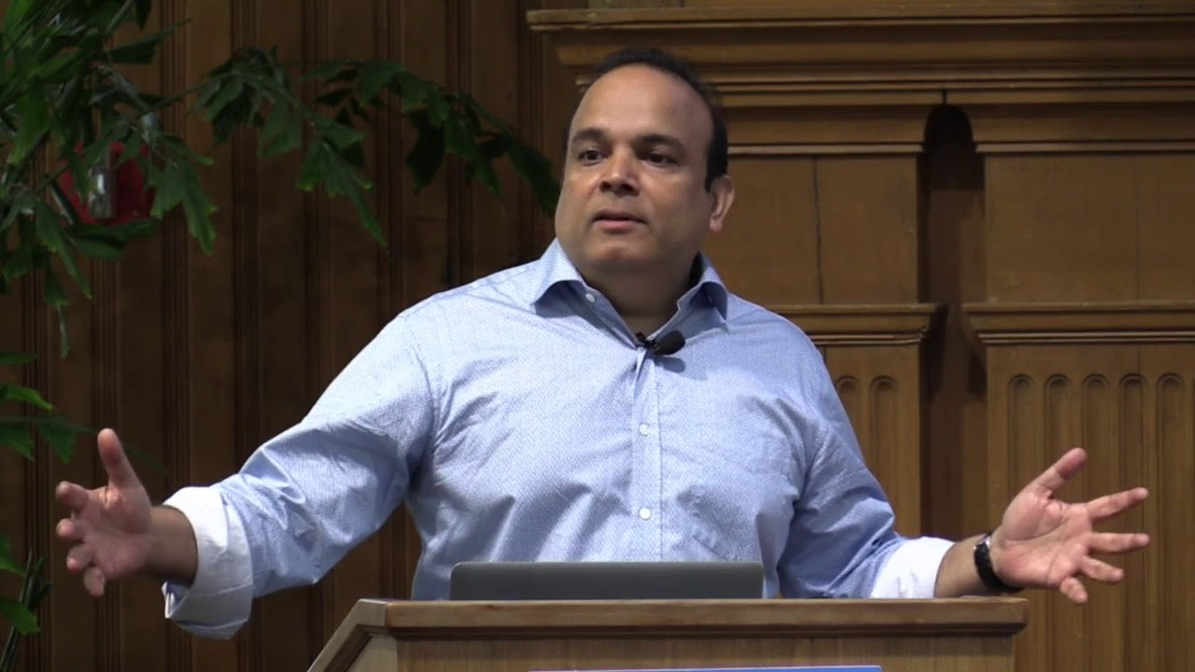
Timothy Kasbe - CIO Warehouse Group (2017-2018) Now President of ZOHO
His Plan:
Approaching it as Mobile First
Leveraging SAAS i.e Zoho, IBM Cloud, Saleforce.com
Using brick and mortar assets as competitive advantage.
[1]https://www.cio.com/article/3508926/the-warehouse-group-taps-ibm-cloud-for-digital-transformation.html [2]https://www.youtube.com/watch?v=JEIseOj-OWw

Slide 3
How did he bring about the digital transformation:
“CIO Kasbe is one of only six executives who report directly to the CEO. His job is to bridge the gap between technology innovation and a brick-and-mortar foundation. “I seed my team in every part of the company,” he said. “My people sit with the marketing team and shadow the buyers. We aren’t waiting for someone to write a requirement anymore. We’re looking for the most powerful ideas, and then we provide the tools to make them work.”
The Warehouse Group has adopted software-as-a-service technologies like Salesforce.com and Zoho to remove the burden of managing infrastructure and let its people focus on what they do best. The cloud has given the CIO room to innovate. “It’s a beautiful thing to have problems solved by the service provider,” Kasbe added.” [1]
[1] https://www.informationweek.com/strategic-cio/why-cios-will-lead-digital-transformation/a/d-id/1332960

Slide 4
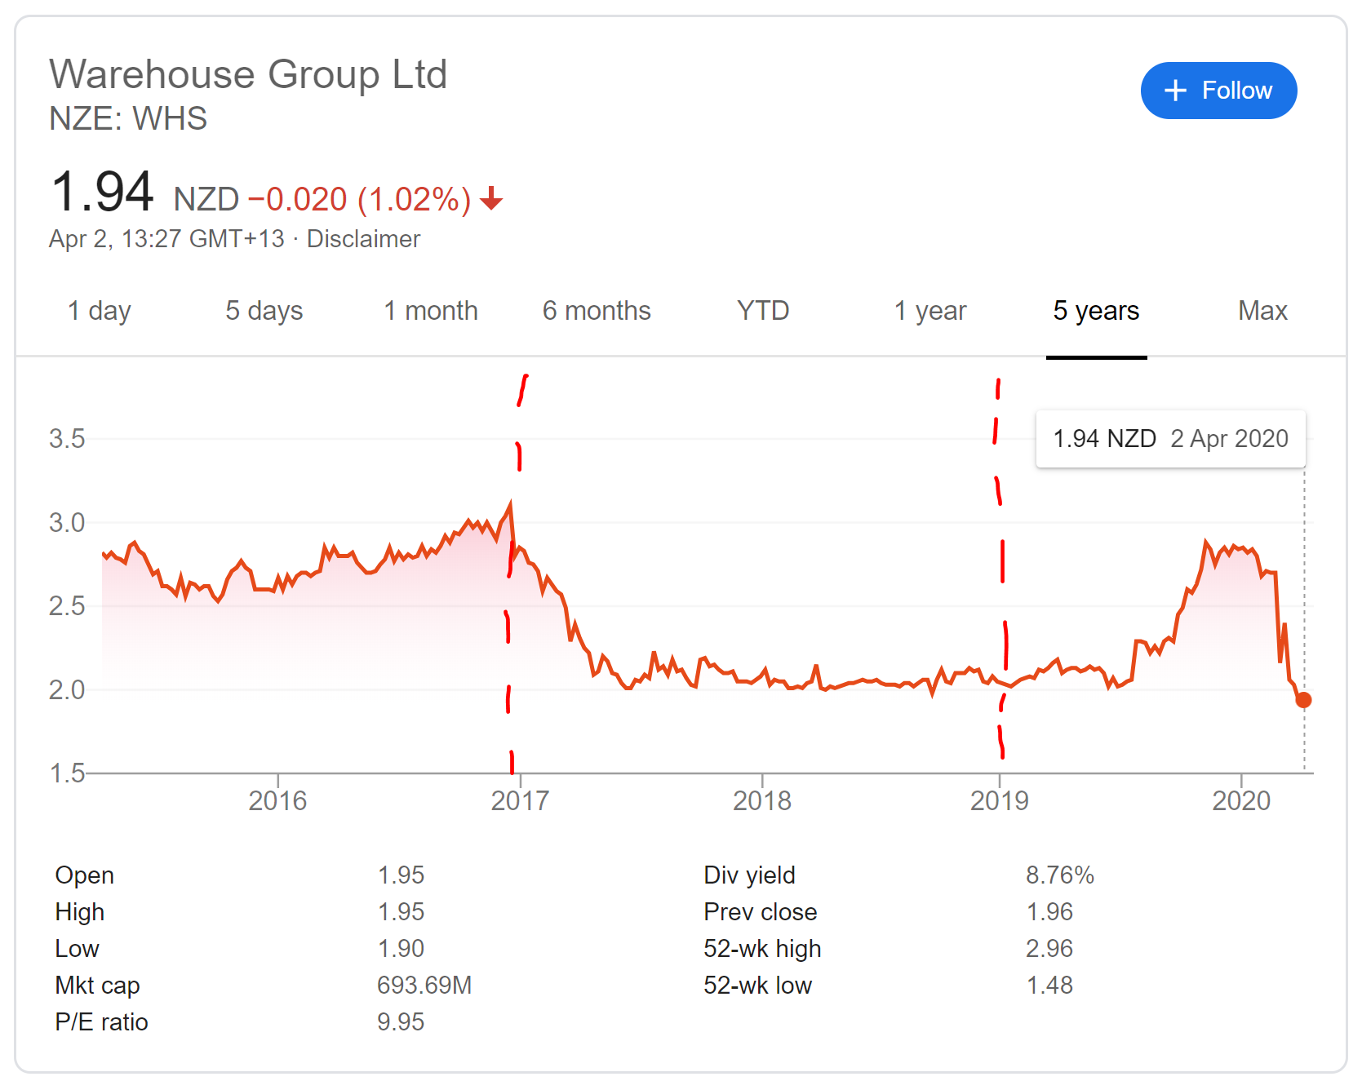
Success or Failure?
Somewhere in between. Articles from 2018 consider whether the company is a good buy and cite slightly above average performance. Stock performed on historical avg. There’s been no significant articles on the results.
[Text]https://simplywall.st/stocks/nz/retail/nzx-whs/warehouse-group-shares/news/with-an-roe-of-14-25-has-the-warehouse-group-limiteds-nzewhs-management-done-a-good-job/ [Graph]https://www.google.com/search?sxsrf=ALeKk00qu319ndjRclYjDfPwYvYcMfhDTQ:1585788121968&q=NZE:+WHS&stick=H4sIAAAAAAAAAONgecRoyi3w8sc9YSmdSWtOXmNU4-IKzsgvd80rySypFJLgYoOy-KR4uLj0c_UNkrPLsiuyeBaxcvhFuVophHsEAwBmdYX6RQAAAA&sa=X&ved=2ahUKEwjkmsuNwcjoAhVvErkGHYrNAqgQsRUwGXoECA8QAw&sxsrf=ALeKk00qu319ndjRclYjDfPwYvYcMfhDTQ:1585788121968&biw=1536&bih=818

Slide 5
Backup Slides
Digital transformation doesn’t mean abandoning what made the company successful in the first place. The Warehouse Group’s 300 locations extend its reach to within a 30-minute drive of every TV in the country. It will leverage that physical advantage to enhance the digital experience, blocking out online-only competitors.

